Slide 1
eXtend Collection Tree Protocol
Bruno P. Santos¹
with
Marcos A. M. Vieira¹
Luiz F. M. Vieira¹
¹Universidade Federal de Minas Gerais, Brazil.

Slide 2
Communication paradigms on WNS many-to-one, one-to-many, and any-to-any
Anycast route to the sink(s)
Used for data collection from the network
Problem
Impossible to check data delivery
Sink
Notes:
First two paradigms allow the collection and dissemination of data respectively. However, with routing on
only one direction, it is infeasible to build reliable mechanisms to ensure the delivery of data end-to-end.
This slide presents collection paradigm

Slide 3
Communication paradigms on WNS many-to-one, one-to-many, and any-to-any
Flooding or sending anycast routes from sink to nodes
Used for data dissemination in the network
Used to reconfigure nodes
Problem
Impossible to check data delivery
How can we create anycast routes for dissemination?
Sink
Notes:
First two paradigms allow the collection and dissemination of data respectively. However, with routing on
only one direction, it is infeasible to build reliable mechanisms to ensure the delivery of data end-to-end.
This slide presents dissemination paradigm
Com anycast routes for dissemination quero dizer que posso escolher um subconjunto de nós para disseminar dados ao invés de toda a rede.

Slide 4
Communication paradigms on WNS many-to-one, one-to-many, and any-to-any
More generic paradigm
Enable unicast routes between any pair of nodes
Problem
Adds more complexity
Requires large amounts of memory to storage routes
sometimes impractical in WNS
Sink
Notes:
Any-to-any paradigm solve the problem to ensure the delivery of data end-to-end.
Enable bidirectional paths for each node in the network.
BUT
Require more state for storage routes and add complexity in code = more memory (scarce resource of WSN)
Most application in WNS does not need P2P communication. WNS application need ways to communicate between sensor nodes to sink and sink to sensor node.

Slide 5
eXtend Collection Tree Protocol (XCTP)
An extension of the Collection Tree Protocol
XCTP creates reverse path enabling communication from:
Sink to nodes
Nodes to sink
XCTP requires
Small space for routes storage
Addition of a very low overhead in packets
Sink
Notes:
XCTP goes beyond then CTP. allowing bi-directional communication between sensor
nodes and the root.
XCTP and any-to-any routing protocols enable reliable communication.
However, XCTP reduces the cost to store routes, since XCTP does not need to maintain routes to every peer.
Thus, XCTP need low storage states.
XCTP require very low overhead in data packets by add 1 field (destination)

Slide 6
Prior work
One-to-many
(Dissemination)
Unreliable
Many-to-one
(Collection)
Unreliable
Directed Diffusion,
DRIP, DIP, DHV,
Deluge
CTP, MultiHopLQI,
MintRoute
XCTP
Collection
Reliable
Hydro, RPL, AODV, DSR, Dymo
Any-to-any
Reliable
Notes:
Directed Diffusion and DIP, DRIP, DHV are used for dissemination of small data packets in the network.
Deluge is a protocol that operates under the one-to-many paradigm, which has the objective to propagate large amount of data
CTP is the de-facto standard collection routing protocol for Wireless Sensor Network and his results are better the MultiHopLQI and MintRoute.
Hydro, RPL. AODV, DSR, and Dymo are P2P protocols.
Hydro and RPL use tables schemes to stoge routes for any node.
RPL uses several messages types to create DAGs to routing messages.
RPL uses requires control packets to create downward routes, XCTP does not have this overhead since XCTP takes advantage of the data packets.
AODV, DSR and Dymo floods the network with messages RREQ. DSR uses packet header to store the route path. AODV and DSR are keep routes in memory.
XCTP focus in creating unicast routes to exchange messages in both directions root-to-node and vice-versa. XCTP create the routes using DATA PACKETS instead CONTROL PACKETS.
XCTP also allows non utilized downward routes to be removed through TTL-based policy avoiding memory overhead to store states with peer-to-peer routes that are underutilized.

Slide 7
XCTP Architecture
Control plane
Data plane
Router
Forward table
Interface to upper layer
Link Estimator
Reverse table
Forwarder
Link Layer
Notes:
The XCTP architecture major changes are highlighted in yellow and bold font
To accomplish the task of forwarding packets also in the reverse direction of the standard CTP data flow, we had to modify CTP architecture by adding new features to the protocol rules as well as incrementing the packet format.
We also created a reverse flow table.
The CTP rules were modified at the data and control planes to react appropriately to the two main events:
Reverse flow: correct and efficient installation of the reverse flow rules;
Topological changes: nodes must appropriately react when loops occur or when CTP unicast routes change.
The Router module is responsible for filling the Forward and Reverse tables
The Forward module queries the Forward and Reverse tables, and determines any router inconsistencies to inform the Router module
Upper Layer module is the interface provided to implement components that utilizes XCTP.

Slide 8
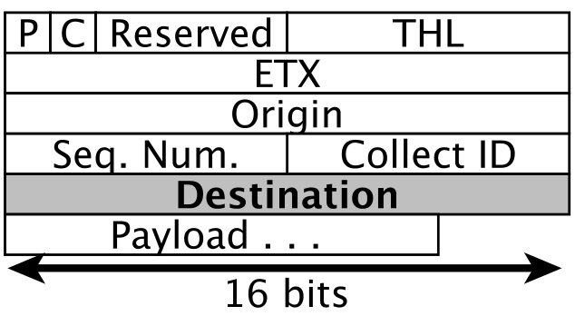
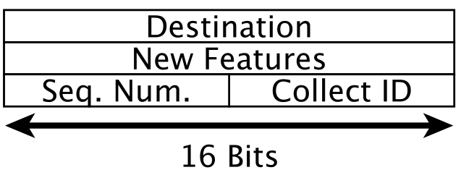
XCTP Packets
Data Packet
Acknowledgment Packet
Notes:
To allow the navigation of the reverse data packet, we added a 16 bits packet field to the data packet to represent the address of the message destination.
All fields are present in CTP data packet, except by “Destination” field
We created Acknowledgment packet type. This packets can be used as feed back command by upper layer protocols.
The New Features field 16 bits is reserved for future features.

Slide 9
Outline
Collection Reliable
Reverse Flows
Topological Changes
Evaluation
Conclusion
Notes:
XCTP create rules in data and control planes to react properly the Creation, Read, Update, and Delete rules in Reverse Table.

Slide 10
XCTP’s Reverse Flows
XCTP create reverse flows for:
Sending a Data Packet or
Sink demand
Reading sequence for downward packets
1st Neighbor (from Link Layer)
2nd Reverse
3rd Forward
Reverse Flow Table Fields
addr dest (tree descendant for 2+ hops distance)
addr next hop
Time To Live (TTL)
Notes:
How XCTP create reverse flows?
Through nodes data packets or Sink demand.
In sink demand: sink send a flood to request node. When nodes intercept the request a data packet is sent. This triggers the mechanism for create reverse flows.
The mechanism is very simple. Each node querys in order the 3 tables Neighbor table (CTP data link Table), Reverse Table (XCTP), Forward (CTP table for next hop for unicast to sink).
Downward rules in reverse table as 3 columns (Destination, Next Hop to, TTL)
Optimization: addr dest: store only XCTP tree descendant, but not 1-hop neighbor. Because this information already exist in Neighbor Table.

Slide 11
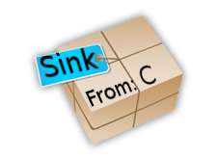
XCTP Reverse Flows (CRUD)
Tree to Sink
CTP creates tree route
Table starts empty
Node C sends a packet
Node A intercepts a packet From C to Sink
Reverse route installed
A: Reverse Table
Dest | Next Hop | TTL
C | B | 10
A: Reverse Table
Dest | Next Hop | TTL
A
B
D
C
Notes:
We present the CRUD for reverse rules in Reverse Table.
When 1 data packet in sent by C. Intermediate nodes (2-hops or more) intercept the packet.
Por example, node A intercept data packets From C to Sink, then Node A install reverve rule (C, B, <number>) for reverse table (addr dest, addr next hop, TTL).

Slide 12
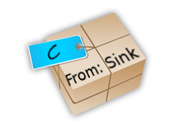
XCTP Reverse Flows (CRUD)
Tree to Sink
Sink sends packet to C
Node A intercepts the packet and read tables
Neighbor table (Not found)
Reverse Table (Found)
Forward table
Node A sends unicast message to B
B delivers message to C
A :Reverse Table
Dest | Next Hop | TTL
A: Reverse Table
Dest | Next Hop | TTL
C | B | 10
A
B
D
C
Notes:
When Sink wants send data or acknowledgments.
Intermediate nodes in reverse route (like A) intercept packets from Sink to some Node in the network.
By intercepting node A applies the simple mechanism, quering the tables.
If node A found rule to packet intercepted then node A send unicast (direct) message.
In this slide A send unicast message to B to reach C.
In wost case node A query Forward table forwarding the message back to Sink (this option can be desabled, thus packet eventually is dropped because TTL mechanism).
Thus node B receive reverse flow to C and delivery properly.

Slide 13
Outline
Collection Reliable
Reverse Flows
Topological Changes
Evaluation
Conclusion
Notes:
In topological changes that Update and Delete happen.

Slide 14
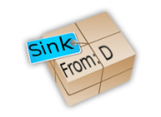
XCTP Reverse Flows (CRUD)
Tree to Sink
Data packets from D are routed by B
Then occurs a link change
Route quality or broken links
Reverse table is out-dated
Update Next Hop to C
A: Reverse Table
Dest | Next Hop | TTL
D |  | 10
C
A
B
B
C
D
Notes:
Reverse Rules are out-date when occurs changes in link along the path between sensor node and sink.
Links are changed by route quality or broken links.
These updates occurs in reverse flow already installed.
In slide the reverse entry (D, B, 10) is out-date when flows from D to Sink became forwarded by C instead B.
In other words.
Data packets from node D towards the root was forwarded by node B and changed to be forwarded by node C due to changes in link quality.
Thus the data plane of node A must be updated to reflect this new configuration
the reverse flow should be forwarded by node C.
The correct rule is (D, C, 10)

Slide 15
XCTP Reverse Flows (CRUD)
There is a link failure causing a loop
The reverse table is out-dated
All entries are invalid
Actions
XCTP removes all entries
CTP must calculate a new tree to sink
Reverse flows entries are rebuilt with new Data Packets
Tree to Sink
A: Reverse Table
Dest | Next Hop | TTL
A: Reverse Table
Dest | Next Hop | TTL
D | B | 10
. . . | . . . | . . .
Tree to Sink
A
B
C
D
Notes:
Deletes in reverse table are realized when occurs loops in the network.
CTP find loops using gradient scheme (like ETX metric).
By finding a loop XCTP the reverse entries and should be deleted.
In slide:
we show the initial reverse flow table. Then, there is a link failure which causes a loop between nodes A, B, and D.
In the event of a loop, the data plane marks, in the reverse flow table, the nodes that were descendants and now are parents in the routing tree.
The action taken when loops are detected by XCTP data control is to delete all table entries.
CTP ensure that new tree to sink will be established.
When new data packets are sent, then new reverse routes are installed.

Slide 16
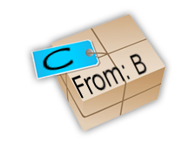
XCTP permits paradigm any-to-any
Tree to Sink
B wants to send data to C
There is no direct route
B sends the packet in the sink collect route
Node A query tables
Neighbor table (Not found)
Reverse Table (Found)
Forward table
Then node A sends the packets down
In worst case, the packets will go to the sink and down to C
A: Reverse Table
Dest | Next Hop | TTL
C | X | 10
A
B
C
Notes:
XCTP permits paradigm any-to-any this is possible due to how the reverse route is constructed.
In slide. If node B send packets with destination C. Intermediate nodes that have reverse rules for C will forward the packets.
When node have not reverse entries, so there are two possibilities.
1 – Drop packets
2 – Forward in sink route
If 2 is pick up, then any-to-any is possible.
In worst case the packets will go to the sink and towards C. We assume that the sink can properly handle this kind of package.

Slide 17
Transport layer over XCTP
We implement the Transport Automatic Piggyback Protocol (TAP2)
TAP2 uses for error-control
Piggyback
Automatic Repeat-reQuest (ARQ)
Notes:
Using upper layer interface of the XCTP, we implement a reliable transport protocol.
TAP2 uses Piggyback and Automatic Repeat-reQuest (ARQ)
The requirements of a few computing resources and its simplistic implementation were reasons why we chose this approach in our work.

Slide 18
Outline
Collection Reliable
Reverse Flows
Topological Changes
Evaluation
Conclusion
Notes:
XCTP create rules in data and control planes to react

Slide 19
XCTP experiments
We made comparisons with different protocols
AODV and CTP in TinyOS implementation
RPL in Contiki implementation
We run experiments on TOSSIM
10 different topologies
10 simulations in each scenario
Curves are average
Bars are C. I. 95%
Parameter | Value
Base station | 1 center
Number nodes | 100
Radio range (m) | 100
Density (nodes/m²) | 10
Number of experiments | 100
Bytes transmitted | 1024
Path loss exponent | 4.7
Power decay (dB) | 55.4
Shadowing Std Dev (dB) | 3.5
Notes:
There are no stable and open source implementations of Dymo, Hydro and DSR.
We try to use Tymo, however this implementation did not show stable as reported in documentation.
We use LinkLayerModel Tool from TinyOS to generate the topology and connectivity model.
Channel parameters are chose to represent a Football Field.

Slide 20
XCTP evaluation goals
Reliable?
Packet delivery to sink
Robustness?
Presence of faults and on different topologies
Scalability?
Memory for routes and for different amount of nodes
Control Traffic
Beacons to maintaining routes
Memory requirements
Code and initial tables

Slide 21
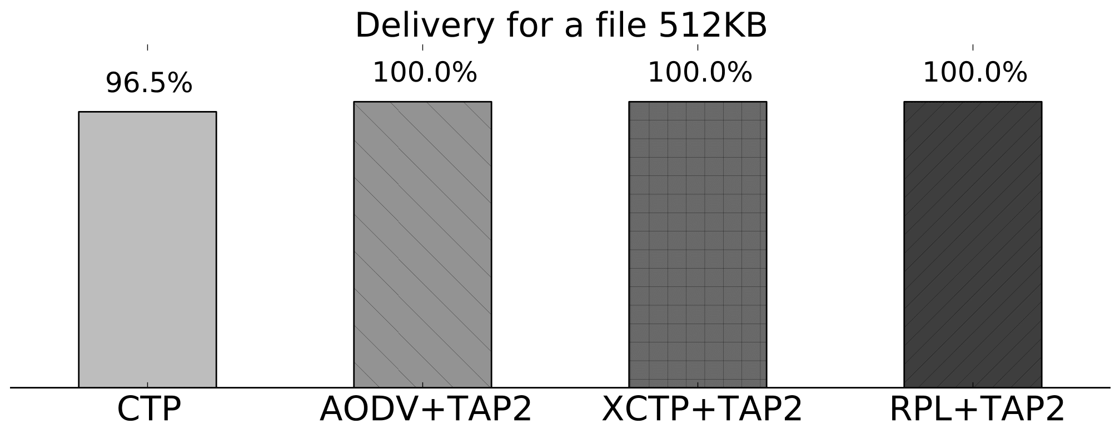
XCTP evaluation Reliable, Robustness, Scalability, Control, Memory
CTP does not permit bidirectional routes
Notes:
Percentage of delivery of a file of size 512KB sent from the root to a sensor node 5 hops away.
We observed that CTP can transfer only 96.5% of the 512KB, because it is not possible to request lost data or confirm received messages
The impossibility of requesting the remaining fragments results in malfunctioning the application that is intolerant to data loss

Slide 22
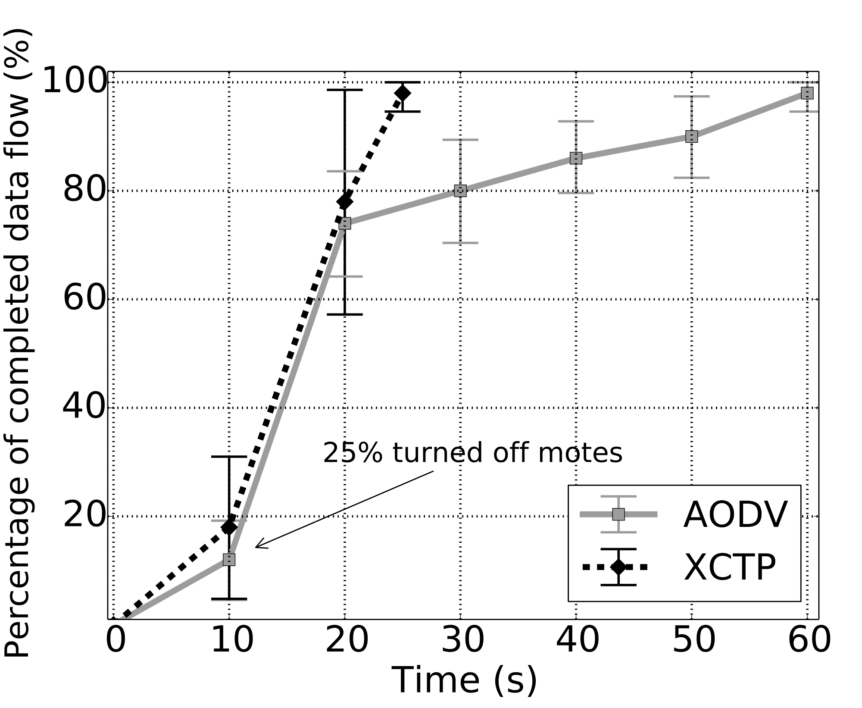
XCTP evaluation Reliable, Robustness, Scalability, Control, Memory
XCTP reacts quickly
finding new routes
Experiment #1
Insert network failure
5 active flows
25% of the nodes turned off
AODV takes a long time to react
ADOV takes over 200s to finish in some scenarios
XCTP on average takes 25s to complete all transfers
Notes:
5 active flows (5 sensor nodes transfer)
XCTP reacts quickly finding new routes to the root
AODV reacts slowly to topological change
XCTP is more fast to recover network failures than AODV

Slide 23
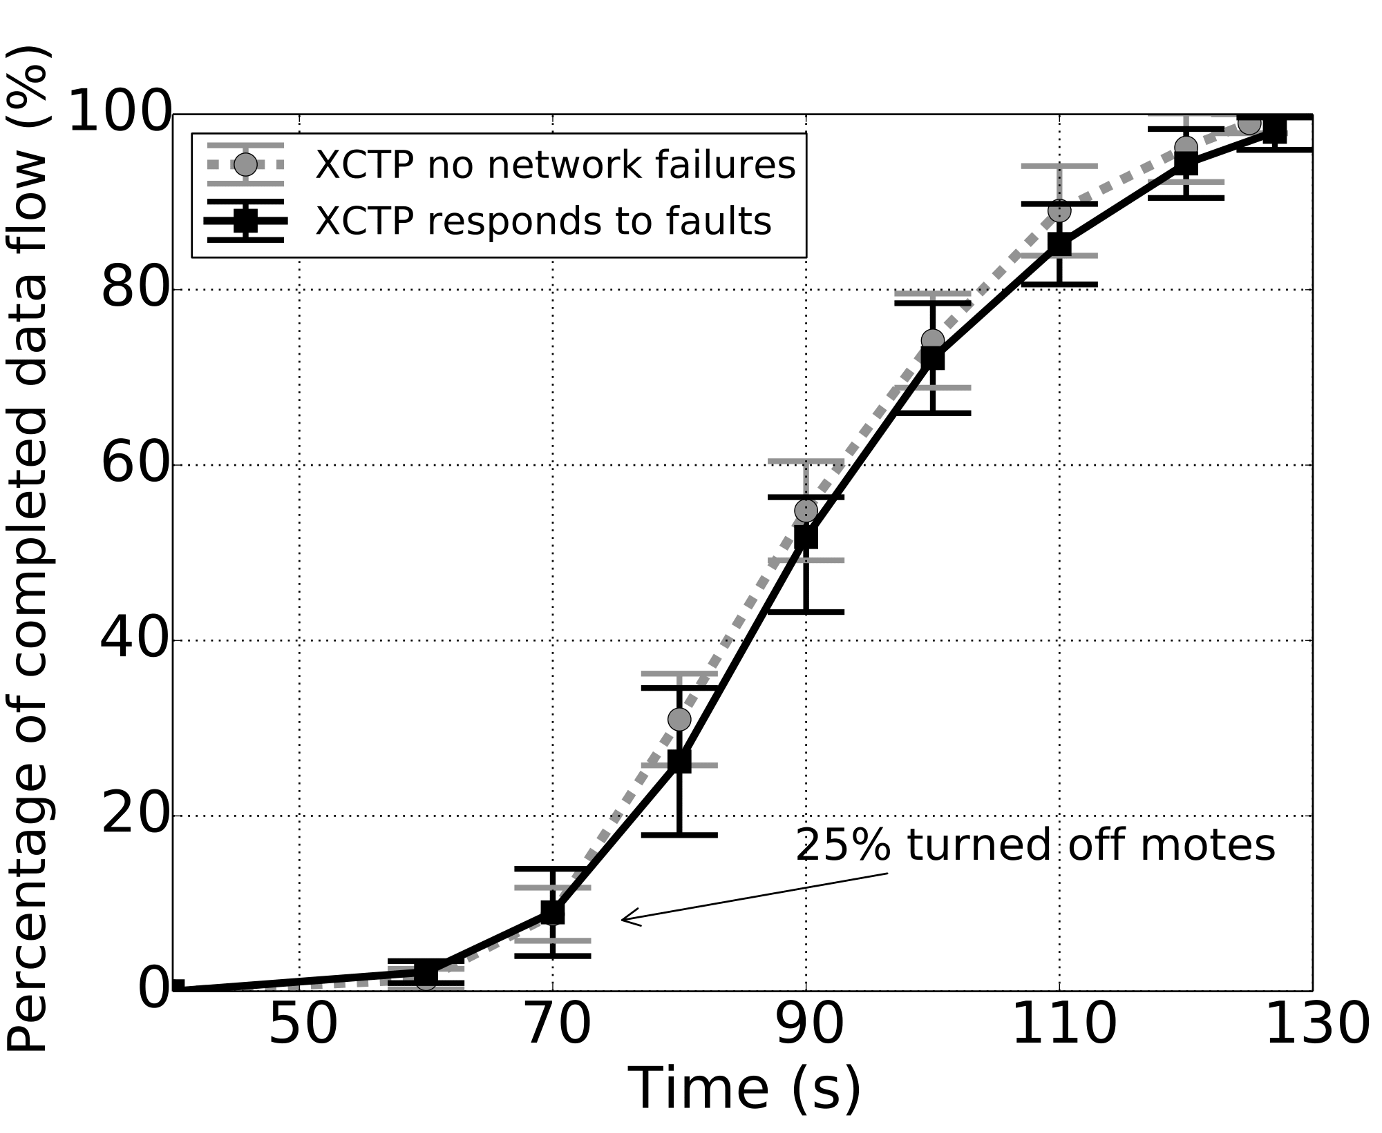
XCTP evaluation Reliable, Robustness, Scalability, Control, Memory
Experiment #2
Insert network failure
50 active flows
25% of the nodes turned off
XCTP presented no difference with or without network failures
Notes:
The same experiment, but 50 active flows with the root.
XCTP, even after the partial shutdown, quickly rebuild routes to the root and continues to transfer data. With average 2 minutes of simulation,
all nodes end the data transfer.
Thus XCTP is agile even in presence of faults and with many concurrent flows in the network.
AODV is not shown because it can not operate with more than 5 flows.

Slide 24
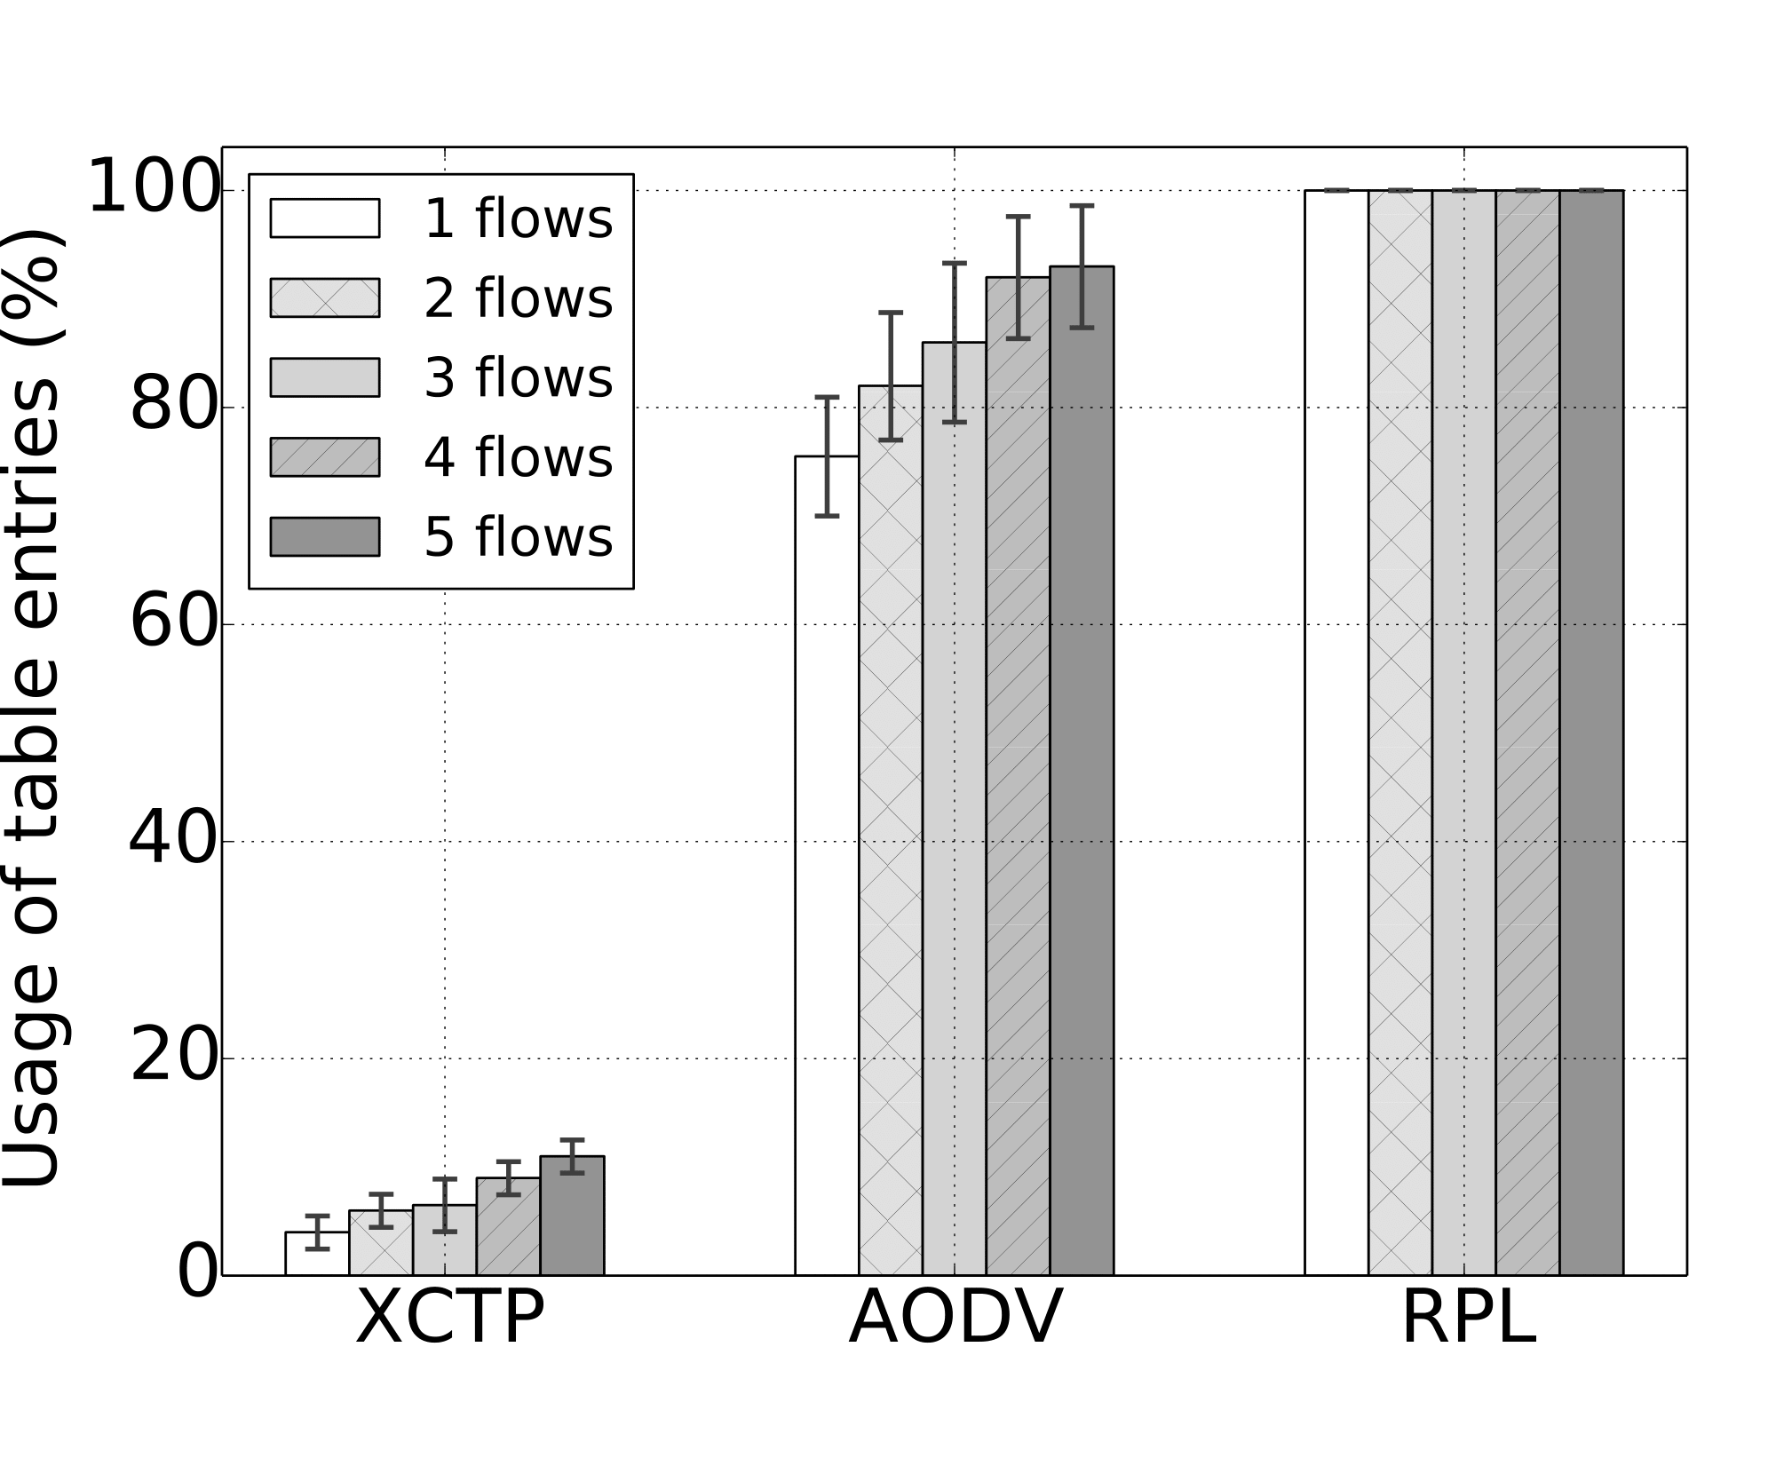
XCTP evaluation Reliable, Robustness, Scalability, Control, Memory
RPL always uses all entries in routing table
Uses TTL to remove under-utilized routes
Table full causes:
Discards requests for new routes
or
No connection for some nodes
82% less table space than AODV for the same amount of flows
5 flows AODV consumes almost 100% of the routing table
Notes:
RPL always installs all possible reverse routes, independent of traffic demand. Some intermediate nodes will not be able to
store all downward routes, thus, causing disconnection between some nodes.
We notice that with 5 flows AODV consume 100% of the routing table. When many flows coexist and the routing table is full, AODV
is obliged to dismiss requests for new routes.
XCTP attempts solve this problem with TTL-based policy over under-utilized routes and only stores reverse routes on demand.

Slide 25
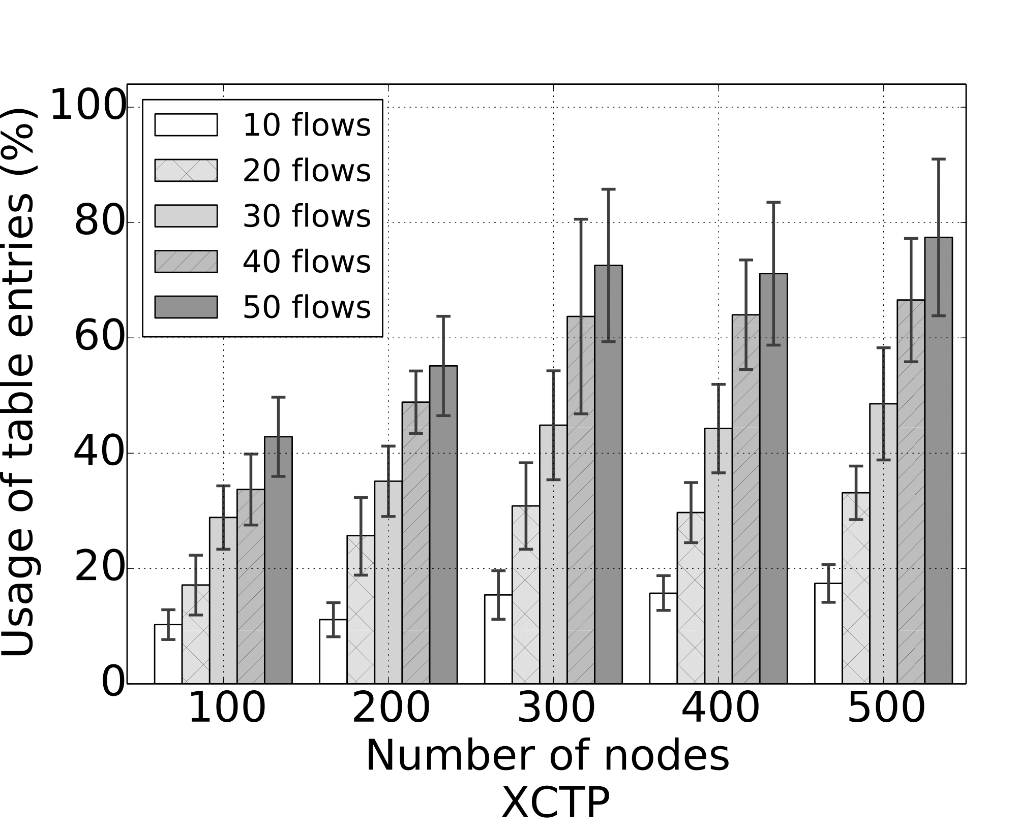
XCTP evaluation Reliable, Robustness, Scalability, Control, Memory
XCTP
operates under the Reverse Table limit
XCTP is robust and scalable

Slide 26
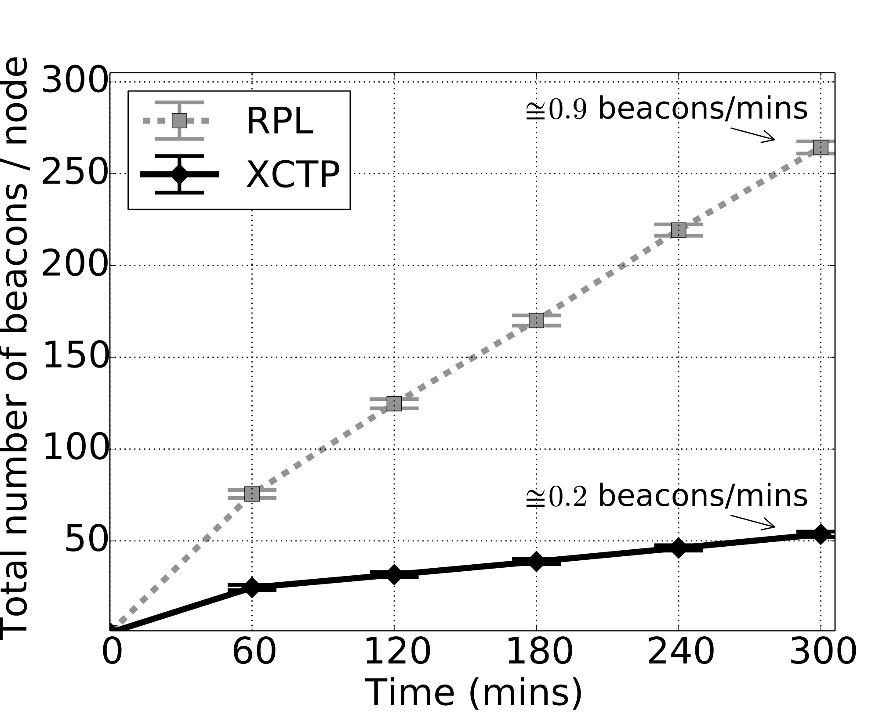
XCTP evaluation Reliable, Robustness, Scalability, Control, Memory
Control Traffic Overhead
Five-hours of experiments
XCTP sends fewer control packets than RPL
RPL needs additional beacons to create reverse routes
Notes:
XCTP and RPL control traffic are high at network start up, but they decrease and stabilize over time.
XCTP sends fewer control packet than RPL because XCTP does not send additional beacons to build reverse routes.
Além disso XCTP usa o algoritmo Trickle para regular o número de beacons na rede.
O número de beacons aumenta quando a rede encontra-se instável e poucos poucos beacons quando a rede é estável.

Slide 27
XCTP evaluation Reliable, Robustness, Scalability, Control, Memory
Using TAP2
ADOV < XCTP < RPL
XCTP requires less RAM than AODV and RPL
XCTP add few lines of code to CTP ≈ 1KB
 | CTP | RPL | XCTP | XCTP+TP2 | AODV | AODV + TAP2
RAM (Bytes) | 1505 | 6516 | 1812 | 1968 | 2119 | 2545
ROM (Bytes) | 16204 | 46454 | 17942 | 18435 | 13868 | 14562

Slide 28
Conclusion
We present XCTP a protocol for WSN
Reliable, Robust, Scalable, and Efficient
XCTP creates anycast routes sink-to-nodes and nodes-to-sink
Lessons
It is possible save memory by creating only necessary routes for WNS

Slide 29
Thank you! {bruno.ps, mmvieira, lfvieira}@dcc.ufmg.br

Slide 30
Acknowledgment
We would like to thank for their financial support
CNPq
CAPES
Fapemig
LG
For bug reports, fixes, and discussions
Vinicius Fonseca
Bruna Soares
Erik Britto

Slide 31
Acknowledgment
We would like to thank for their financial support.
Conselho Nacional de Desenvolvimento Científico e Tecnológico (CNPq)
Coordenação de Aperfeiçoamento de Pessoal de Nível Superior (CAPES)
Fundação de Amparo à Pesquisa do Estado de Minas Gerais (Fapemig)
LG

